Slide 1
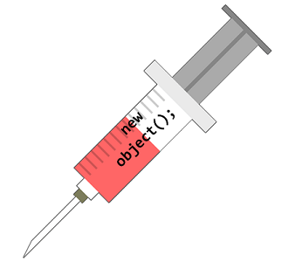
Dependency Injection

Slide 2
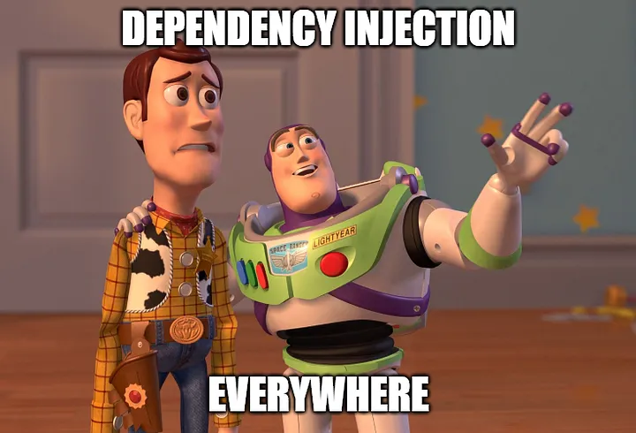

Slide 3

What is dependency Injection?

Slide 4
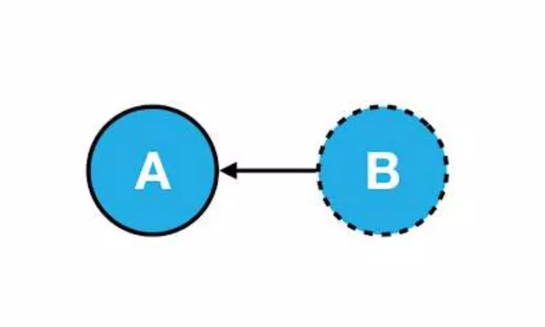
What is Dependency?

Slide 5

What is injection?

Slide 6
Dependency Injection
A set of software design principles and patterns that enable us to develop
Loosely coupled code

Slide 7


All these words ?????

Slide 8
DI simply means………
Ask third party to create something(object) , instead of creating it (dependencies) yourself

Slide 9
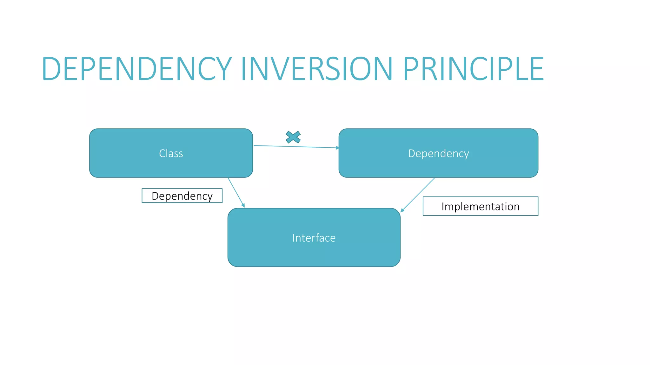

Slide 10

Benefits of DI (loose coupling code)
Easy to extend
Easy to test
Easy to maintain
Facilitates parallel development
Facilitates late binding

Slide 11
Disadvantages of DI (loose coupling code)
Increase code complexity
Can complicate debugging while devlopement

Slide 12
Major ways of implementing DI
Constructor Injection – pass the object of concrete class into the constructor of dependent class
Method Injection – pass the object of the concrete class into the method the dependent class which is actually invoking the action
Property Injection – pass the object of the concrete class via a setter property that was exposed the dependent class.

Slide 13
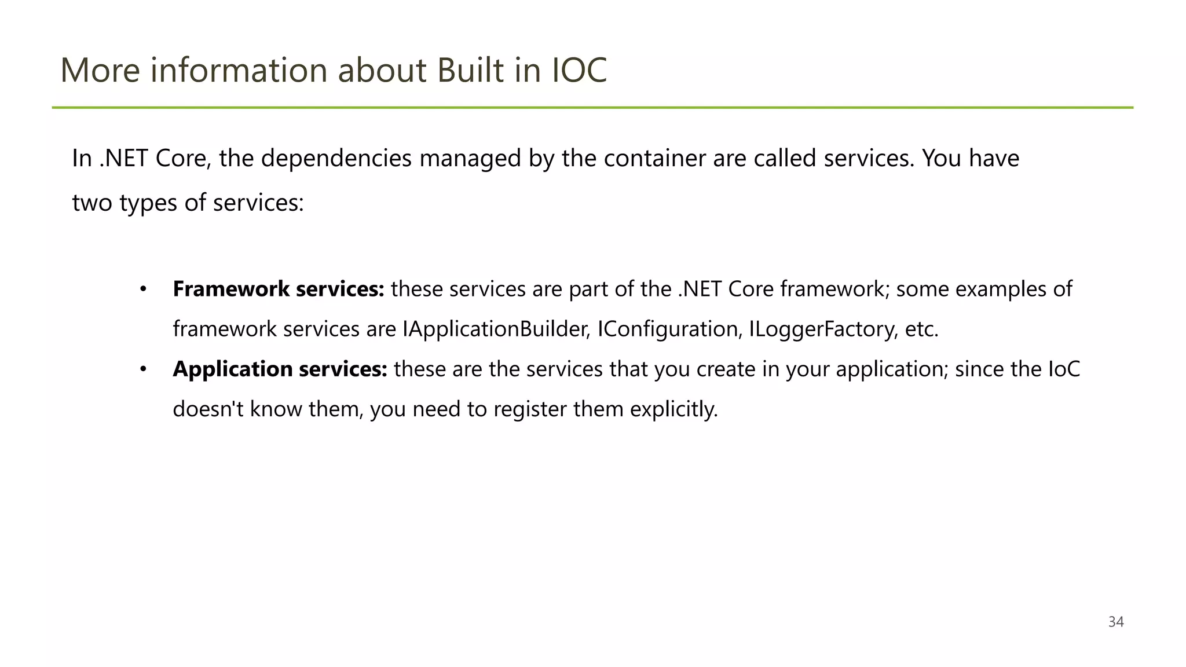

Slide 14
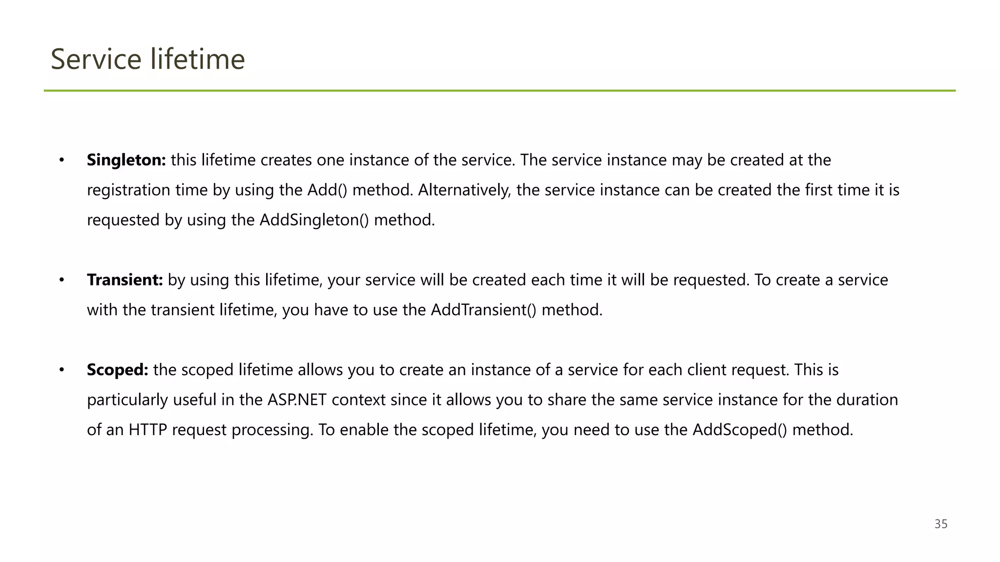

Slide 15
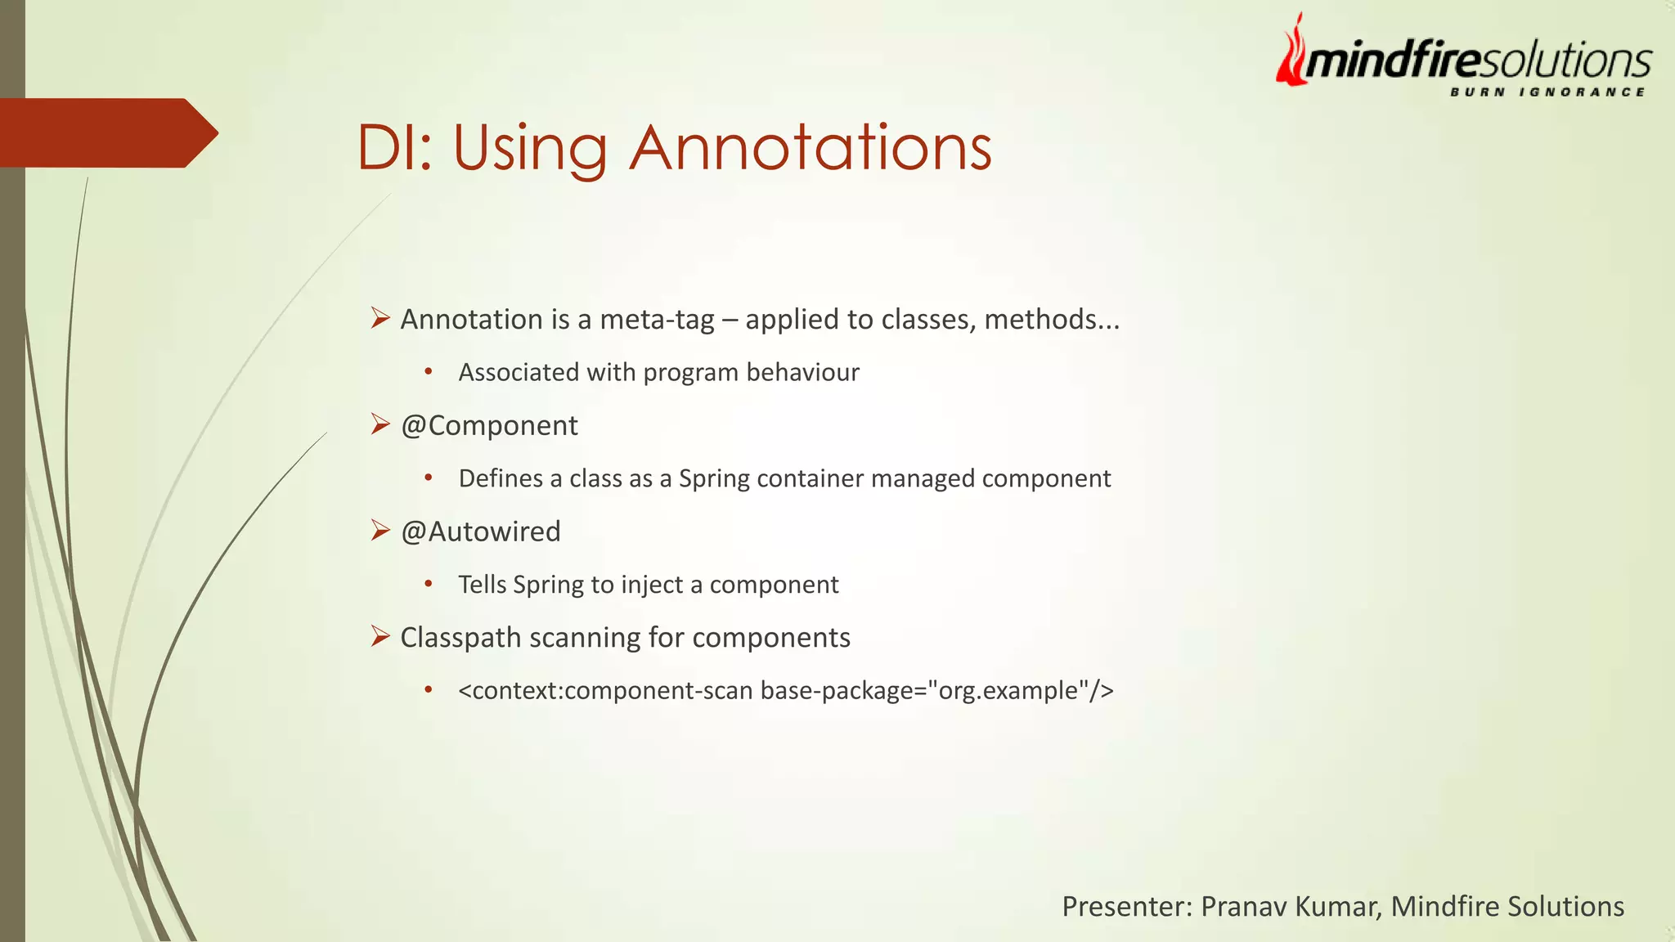










Slide 16

Thank You!

Slide 17
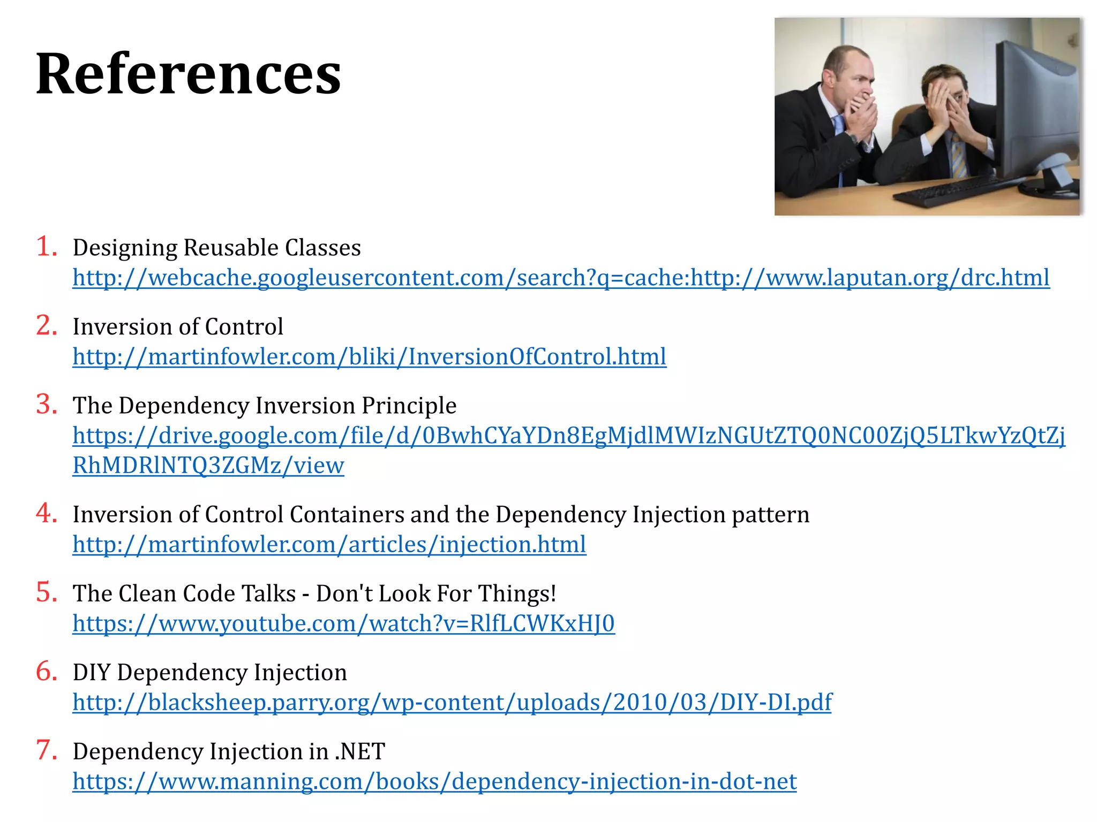
Resources

